Slide 3
Because of this region’s shape and the richness of its soil it is called Fertile crescent.
The rivers flood at least once a year, leaving a thick bed of mud called silt.

Slide 7
Initiated bronze age
They were the first to settle in this region, attracted by rich soil.

Slide 8
Examples of Sumerian cities are: UR, Uruk, Kish, Lagesh.
All the cities shared the same culture.
Each city had its own government/ rulers, warriors, it’s own patron god and functioned like an independent country.
At center of each city was the walled temple with a ziggurat- a massive, tiered pyramid-shaped structure.
Built city walls with mud bricks.
Traded with people around them for the products they lacked.

Slide 9
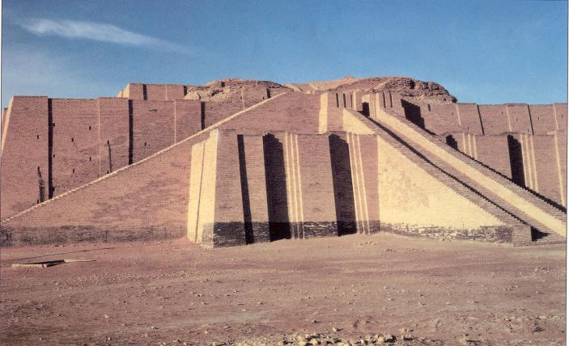
The Ziggurat at Ur was first excavated by British archaeologist Woolley in 1923. The Iraqi Directorate of Antiquities restored its lower stages in the 1980s.

Slide 11
PLANNING OF CITIES
Cities were built around a 100 ft high pyramid shaped building called Ziggurat, which was the temple and astronomical observatory.
In the basic plan a massive wall surrounded the entire city in the center of which located the ziggurat, place and various public buildings.
At the foot of ziggurat there was an extensive rectangular Teminas, it was administrative center constructed with dignity on massive scale.
The lower walls of all public buildings were highly decorated.
They also standardized the bricks.
The walls were built of sun dried or fired brick.

Slide 12
PLANNING OF CITIES
The houses of common people were one or two storey high.
Houses were jumbled together in an irregular mass that was interrupted by public open spaces in the vicinity of temples and other public buildings.
Streets were narrow lanes without surfacing or drainage and only wide enough to allow for the passage of a man and his donkey.
The streets were intersecting each other at right angle and their corners were made rounded to facilitate the movement of loaded donkeys.

Slide 13
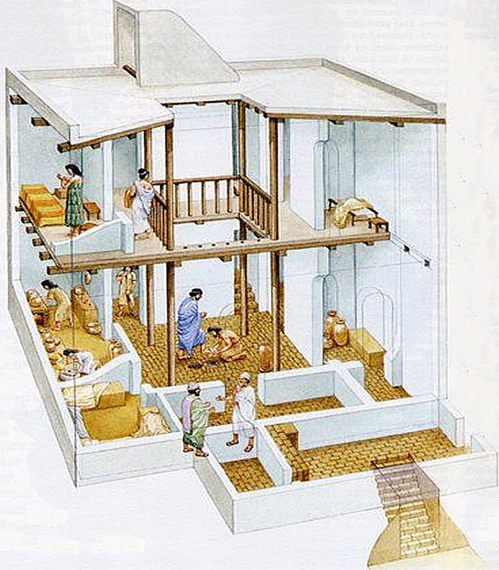
PLANNING OF CITIES
Among the clusters of the houses were chapels, small shops and rows of booths that probably used by artisans and merchants.
Near the outer margin of the city was a zone where the poorest elements of the population lived in mud huts.
Most houses had square center room with other rooms attached to it.

Slide 20
Women had more rights than many later civilizations (could own property) but not allowed to attend schools.

Slide 21
ACHIEVMENTS
SCIENCE AND TECHNOLOGY
One of the first writing system- Cuneiform
Invented wheel, the sail, the plow
First to use bronze.
One of the earliest sketched maps
Astronomy

Slide 22
City states began to war with each other. These internal struggle meant they were weak to ward off an attack by an outside enemy.
Invasions
Internal fighting
Severe famine
All contributed to the end of the Akkadian Empire

Slide 24
CITY OF BABYLON
The city of Babylon was the capital of the ancient land of Babylon in southern Mesopotamia.
It was situated on the Euphrates River about 50 miles south of modern Baghdad.
Historical resources inform us that Babylon was in the beginning a small town that had sprang by the beginning of third millennium. The town flourished and attained notable prominence and political repute with rise of first Babylon dynasty.
Eleven kings ruled Babylon, the most famous was king of Hammurabi.

Slide 25
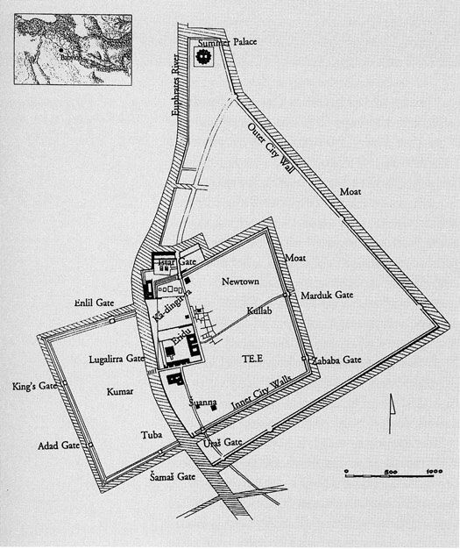
CITY OF BABLYON
Hammurabi paid greater attention to matters of irrigation as well as the religious, economic and justice affairs of the state and people.
He wisely took all the laws of the region’s city state and unified them in one code. This helped unify the region.
Strict in nature- (eye for an eye) the punishment fits the crime.
He preserved all the codes in the legal document.

Slide 26
CITY LAYOUT FEATURES
There were 24 streets in Babylon, running parallel to the river or at right angle.
The streets were narrow, irregular, ranging from four to twenty four in width.
The streets were not paved but instead created with raw earth.
Streets provided access to the houses, temples and public buildings. They also carried the burden of becoming the dumping grounds for the city.
The threw their garbage into the streets. Then they covered it up with layers of clay. As a result, the streets of Babylon began to rise, and eventually houses needed to be built on higher on higher ground.
Construction was of baked brick, not the usual sun-dried bricks.
Defensive towers were built all along the outer wall which itself surrounded by a moat filled with water.

Slide 27
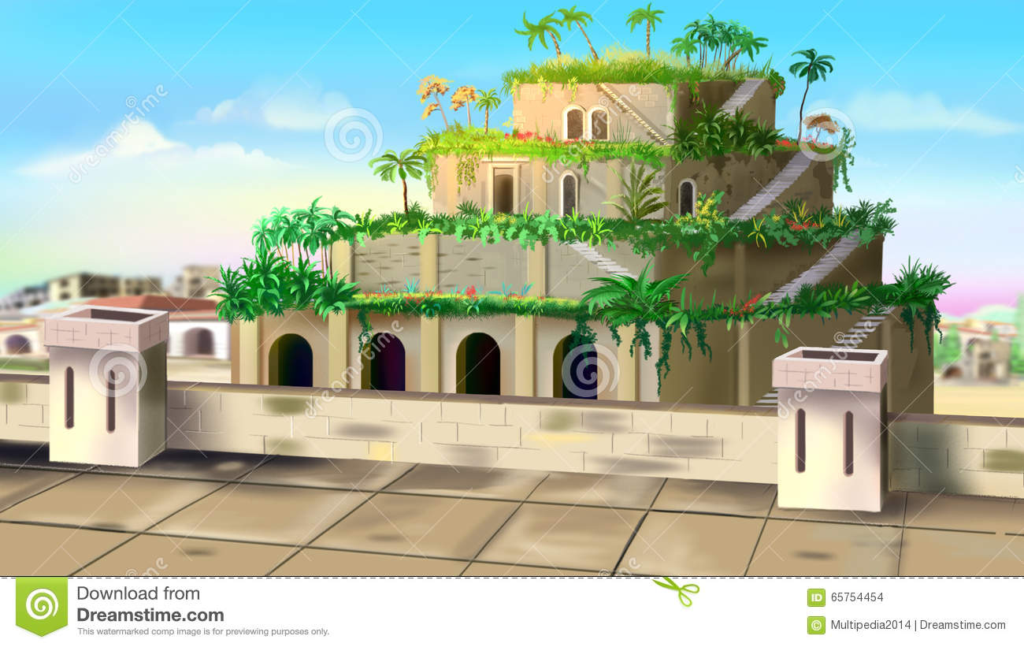
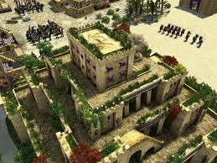
CITY LAYOUT FEATURES
Babylon is famous for its Hanging garden, Ziggurat and Towel of Babel. The city has reached its cultural peak during the rule of Hammurabi and its son.

Slide 33
`

Slide 34
